Slide 1
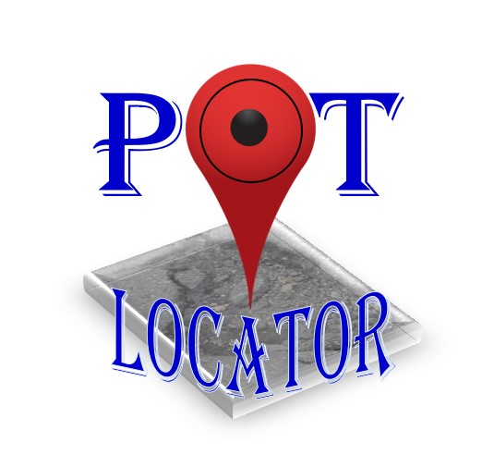
PotLocator
Keyur Kirti Mehta
Term Project - Cloud Computing

Slide 2
Agenda
Introduction & Need
Statistics
Technology Used
Working
Screenshots
Demo
Future Scope
Conclusion

Slide 3

Introduction
Detect pot holes on the roads
Government agency can view/trace
Repair faster
Need
Large road network
Rain and snow damages the road often
Heavy traffic & poor climate conditions

Slide 4
Statistics
Roads (An integral part)
50000 ambulances make 60 million trip/year
32 millions of goods in tracks everyday
240 million vehicles travel 2.9 trillion miles annually
Accidents
33,000 traffic fatalities, one third due to poor roads
Average maintenance cost of vehicle increases by $377
*source: http://www.pothole.info/the-facts
https://www.informs.org/ORMS-Today/Public-Articles/June-Volume-41-Number-3/POTHOLE-ANALYTICS

Slide 5



Technology Used
Client
Java
Android Studio
Sever
Node.js
Microsoft Azure
Database
MySql
*logos displayed are only for representational purpose

Slide 6





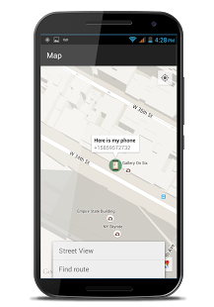
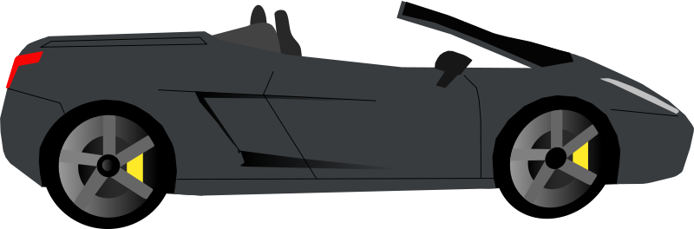

Working

Slide 7
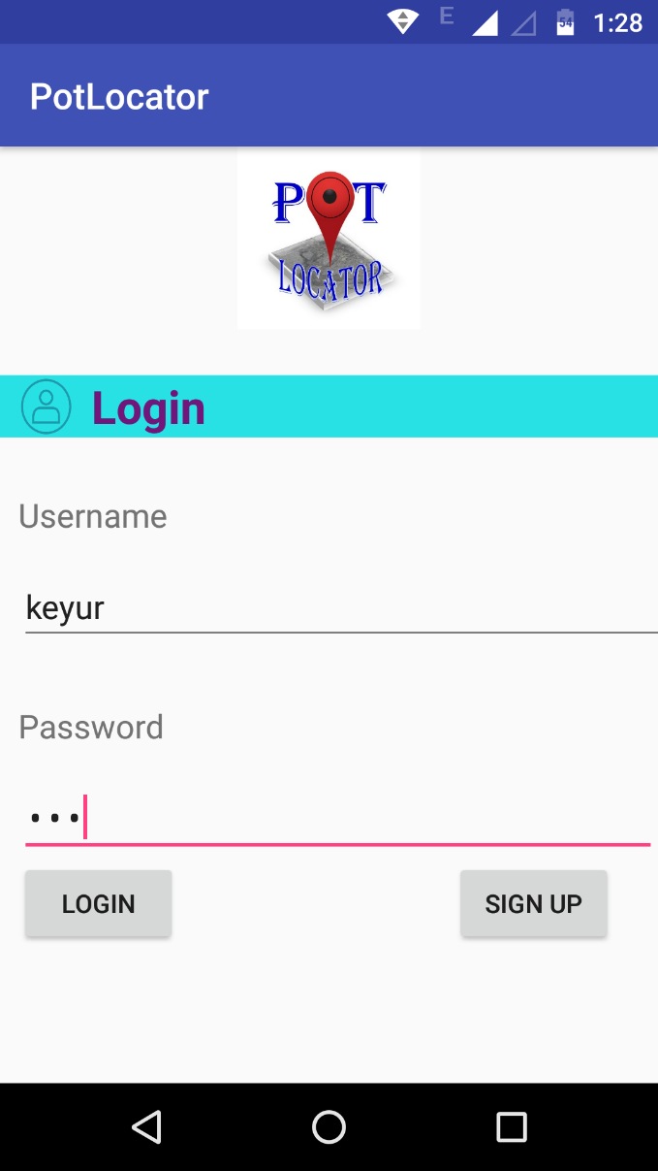
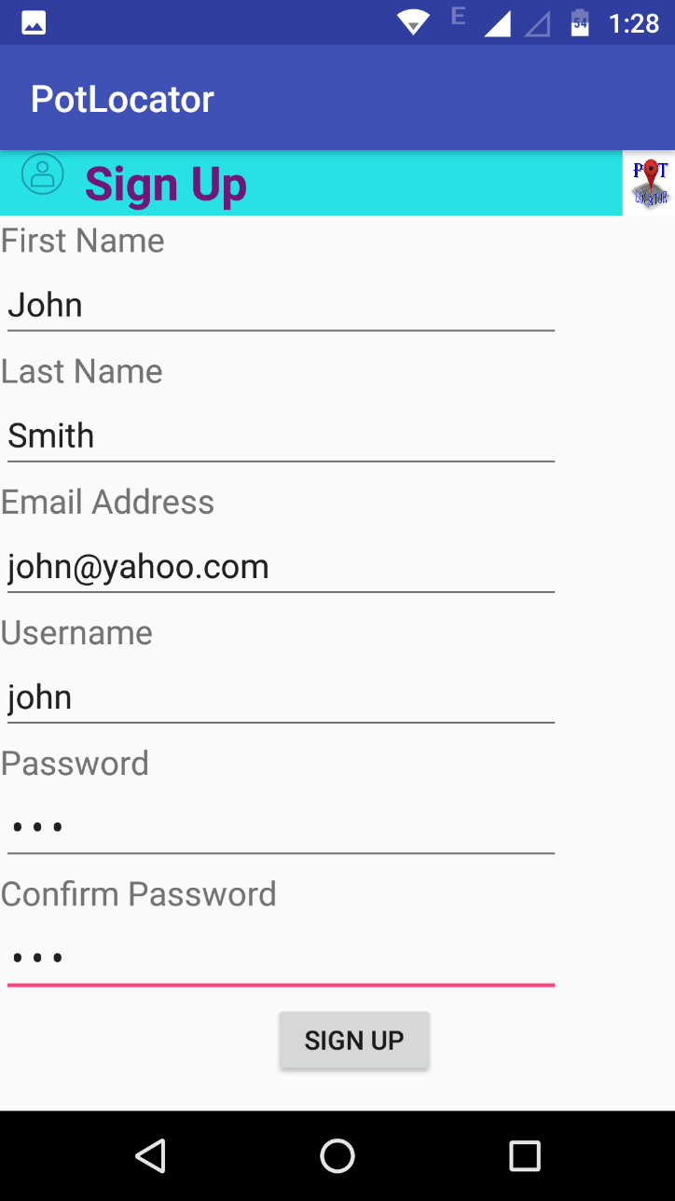
Screenshots (1)
Login
Sign Up

Slide 8
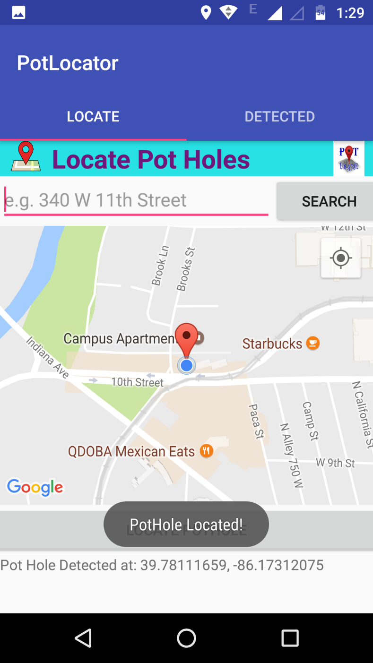
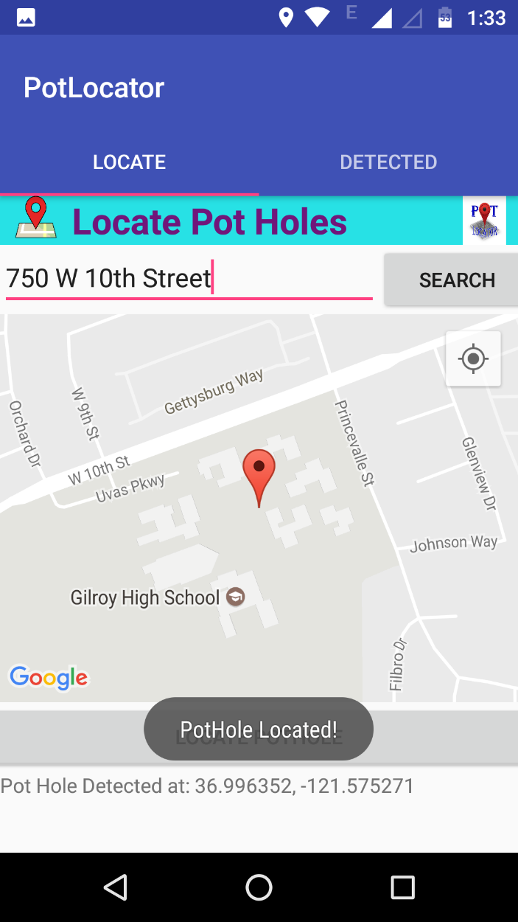
Screenshots (2)
Detect Location (tab 1)
Current Location
Based on Address

Slide 9
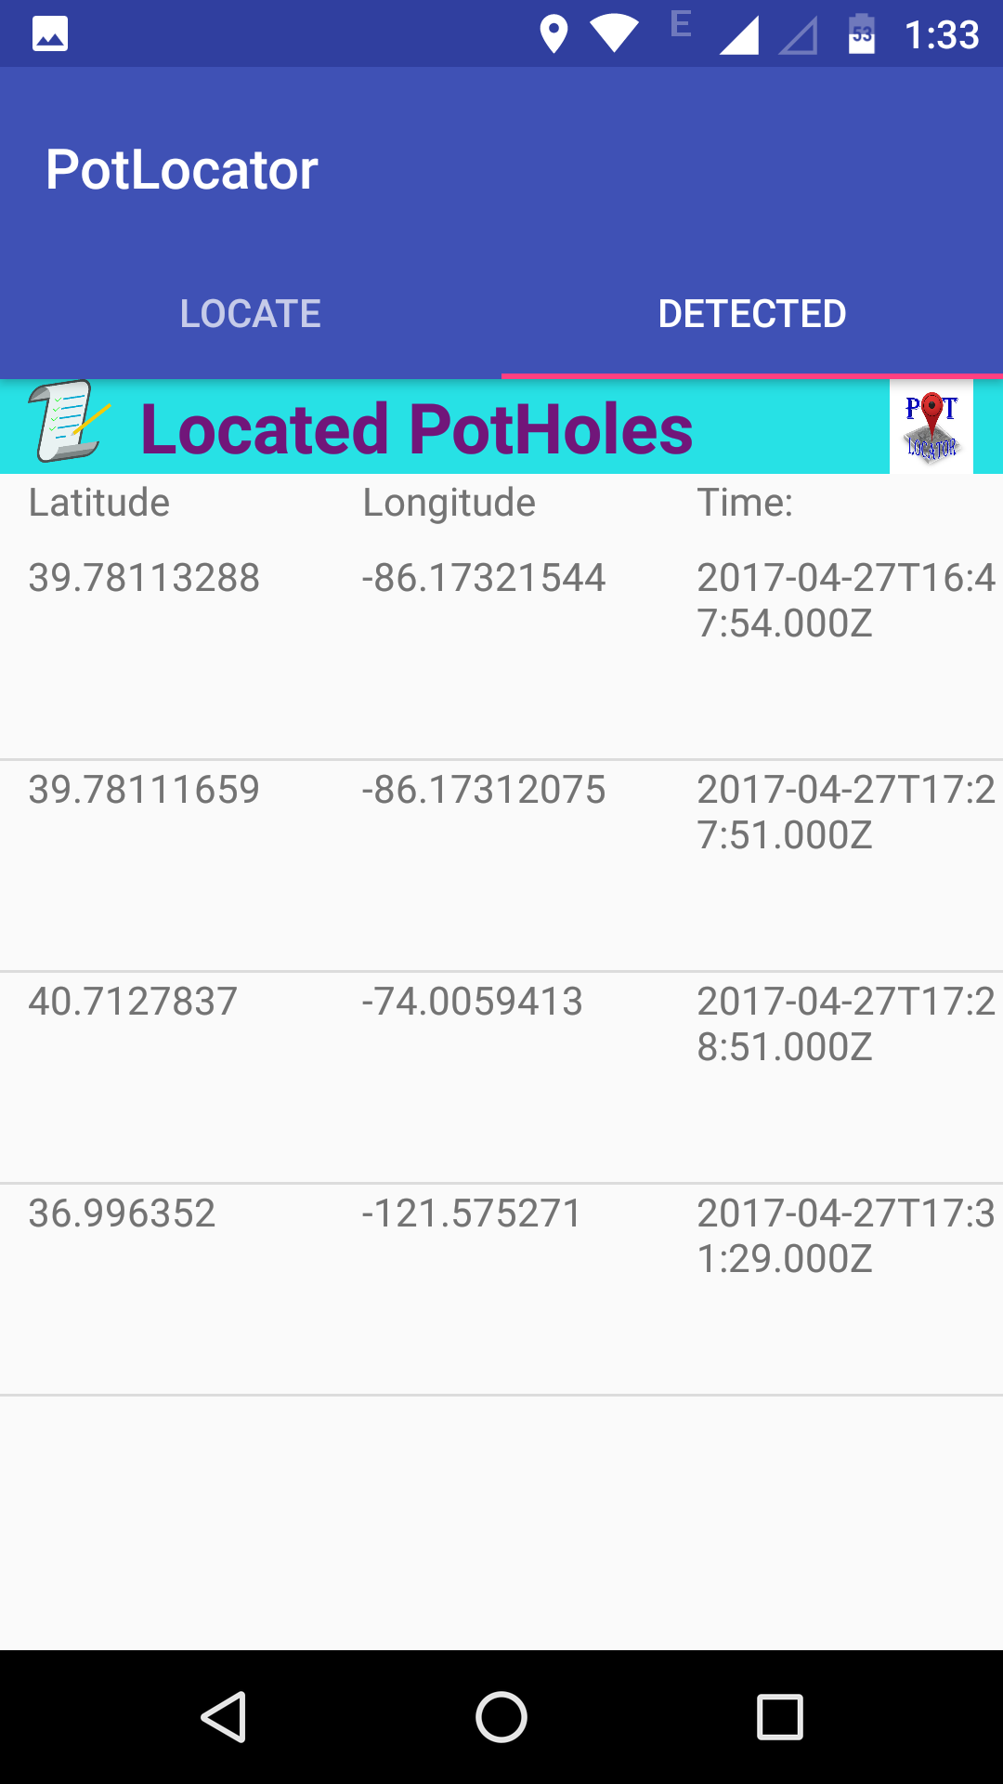
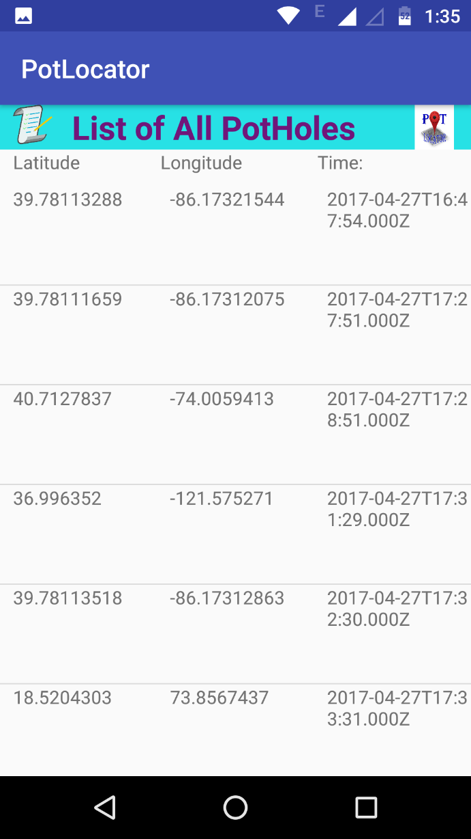
Screenshots (3)
List of Pot Holes
Normal User (tab 2)
Employee User

Slide 10
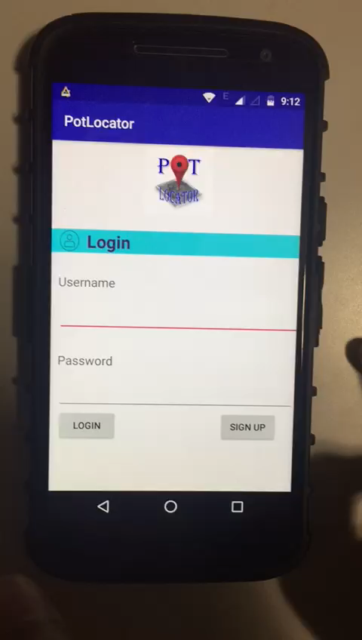
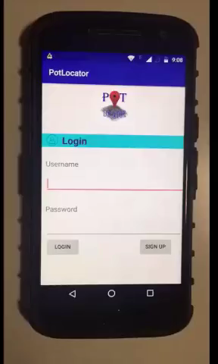
Demo

Slide 11
Future Scope
Detects potholes based on Accelerometer sensors
Pothole repaired functionality
Notify new detected pot hole / repaired pot hole

Slide 12
Conclusion
This app will make process faster
Improve the quality of roads
Ensures safe travel

Slide 13
Thank You!

